Slide 1
Video Source Identification & Tampering Detection
Group No: 21
Group Members:-
Madhavi Bhilegaonkar
Vipul Borhade
Shreya Pai

Slide 2
NEED OF VIDEO FORENSICS
▪In recent years, the authentication and validation of the content has become more and more difficult.
▪This is because of easy and inexpensive availability of digital multimedia devices which has increased the possibility of generating images/ videos without any time, place or network-related constraints.
▪Thus, forging of videos has become much easier because of availability of video editing suites.
▪Videos can no longer be used to prove the occurrence of a certain event
▪The distribution of certain “fake” videos has led to high repercussions in society
Videos are considered much stronger proof than a single picture taken.
Best Evidence- Real Evidence- interpretation of court

Slide 3
INTRODUCTION
▪Video forensics relates to the re-construction of the processing history of a given multimedia signal.
▪The non-reversible operations applied to a signal leave some traces (footprints) that can be identified.
▪These footprints are classified in order to reconstruct the possible alterations that have been operated on the source.
▪One can say that this detection of footprints is a sort of reverse engineering.
▪There are 2 main modules in this project:-
Identification of the source identification device
Video Tampering Detection
▪

Slide 4
Technical Aspect & Legal Aspect
Demonstrative/ Subjectivity
Silent Witness/ Objectivity - CCTVs

Slide 5
Video Source Identification & Tampering Detection
Verifiability & Authenticity
The most important factor that is first established is whether the video is recorded with the device through which it claims to be.
→ Source Camera Identification
“Video is what it claims to be”.
→ Content Manipulation & Post Processing. This includes Tampering. In out project we discuss whether any frames have been added or deleted from the video sequence. Inserting or deleting frames in a video affects the flow of the video. This kind of forgery is called inter-frame forgery.
Taken at date, time and location when it claims to be
→ Event Verification

Slide 6
PRNU (Photo Response Non-Uniformity)
The PRNU (Photo Response Non-Uniformity) Technique is used to find out the authenticity of the source of the video.
Acquisition Chain
Screen → optical lens → RGB Color Filter Array(CFA) → internal CCD array → in-camera software → lossy encoding → projection/ display
This acquisition leaves individual fingerprints on the acquired content.

Slide 7
PRNU noise is a pattern noise that mainly depends on the detector dimensions, doping concentrations, the thickness of overlayers and the wavelength of illumination (spectral response) .
In other words, it is caused by the peculiarities/ imperfections in sensors. As PRNU is non-linear in nature, thus, it becomes extremely difficult to remove and provides a much stronger and more reliable fingerprint than any other noises. Even the compression of videos will not affect this noise.
If we capture this noise pattern, we can create distinctive connections between the source camera and the video.

Slide 8
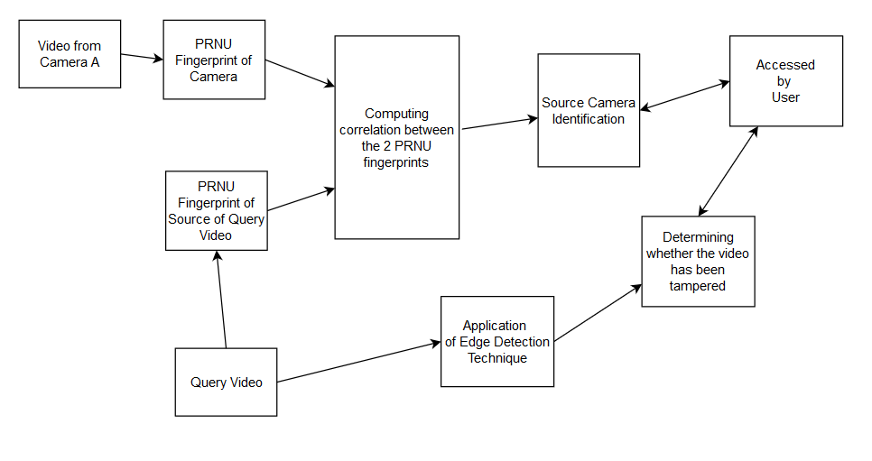
Block Diagram

Slide 9
The Technique
The PRNU Technique will consist of two steps.
The first step comprises of estimating the PRNU fingerprint of the source camera.
Step two comprises of calculating the fingerprint of the query video and then identifying whether the query video has been generated from the source camera by means of the correlation value.

Slide 10
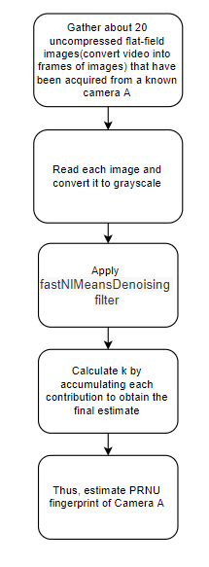
PRNU
Step 1:

Slide 11
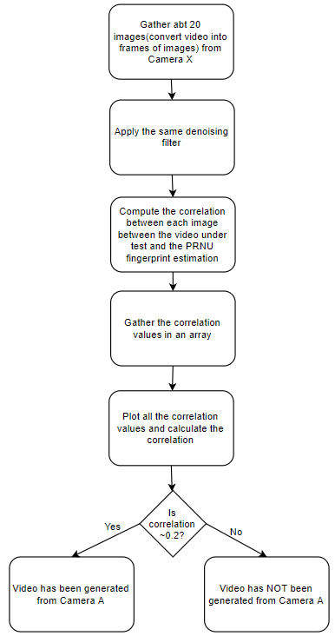
Step 2:

Slide 12
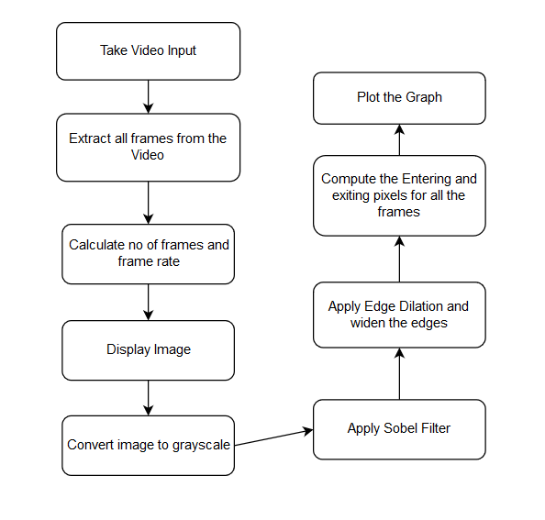
Edge Detection
Technique

Slide 13
Here, we apply the Sobel filter while calculating whether frames have been inserted or deleted.
The Sobel filter is used to perform 2D spatial gradient measurement on an image.
Thus, it emphasizes the regions of high spatial frequency that otherwise correspond to edges.

Slide 14
Frame Insertion & Edge Detection
We plot the graph of frames of a video vs change in the edge between exiting pixels and entering pixels of n th and (n+1) th frame.
The sudden peak in the graph shows that the video is tampered. The value of entering and exiting pixels is determined by image dilation and filtering the frame with Sobel filter.
Then, gaussian smoothing is applied to improve the accuracy of the result.
The graph shows that there are no sudden peaks if video is authentic

Slide 15
Technology Stack
Name | Version
Python - numpy, scipy, cv2 | python 3.5.4 or higher
Matlab - matlab engine | matlab 2018b or higher
Django -forms | 2.2.11 or higher
Web Browser | Chrome 65X or Firefox 25x

Slide 16
Results

Slide 17
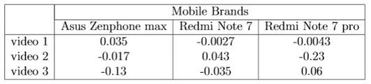
PRNU Result

Slide 18
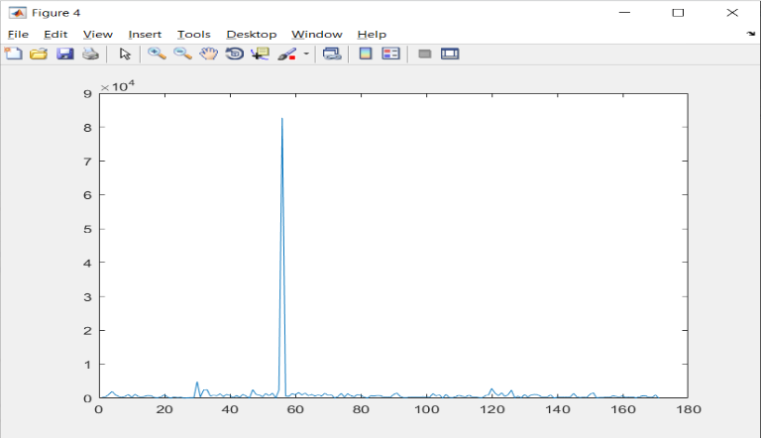
Tampering Result
Edge difference detection graph for a tampered video

Slide 19
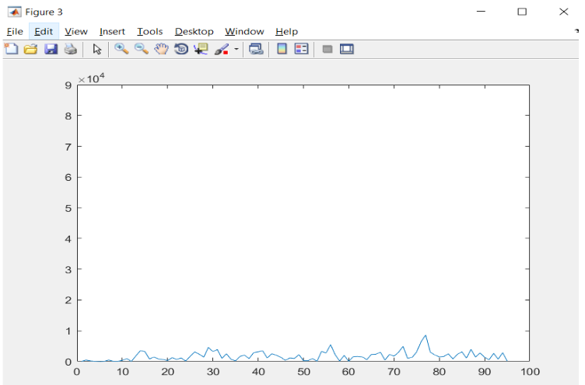
Edge difference detection graph for an authentic video

Slide 20
Thank You!

